Slide 1
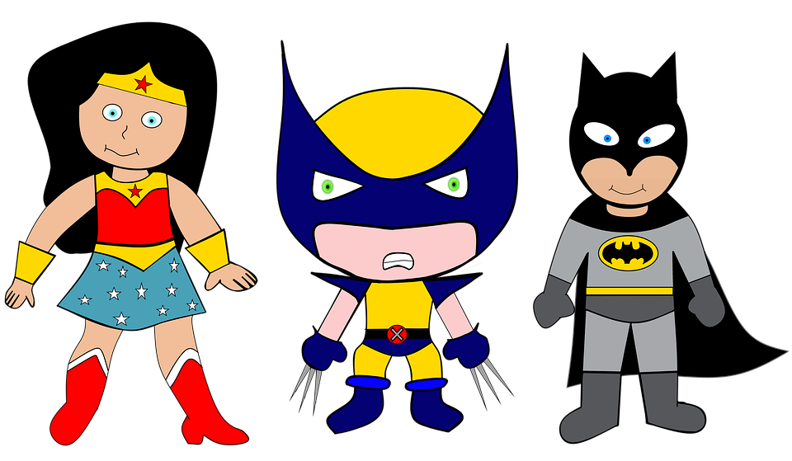
We are SUPERheroes! Students Using their Powers to Engage in Reading!
Kindergarten Newsletter – October 25-29, 2021
IMPORTANT EVENTS
Breakfast ends at 7:25!
10/25 10/26 10/27 10/28 10/29 | Red day Tye Dye day Camo day Team Spirit day (jersey) Career day PLE night at Football game
The EXPERT in anything was once a BEGINNER!
HOMEWORK
Mon. – Thurs. | Weekly ELA Sheet Math HW Pages Practice Sight Words List Read 10 minutes per night
GOOGLE CLASSROOM
We will update you when we get more information on when our google classrooms will be up and running.
WEEKLY ASSESSMENTS
ELA | Module 3.2 test Study Lowercase letter names
Math
WEEKLY MATH SKILLS
2D shapes/Positional words Writing 1,2,3,4,5,6,7,8,9,10 More and Less Decompose numbers 3-10
REMINDERS
Please make sure all money is sent in your child’s blue folder labeled and sealed. If your child is absent, please send an excuse labeled with the following information: Child’s name, date of absence, teacher’s name, and reason for absence.
SCHOOL SAFETY
Be sure your child wears a mask to school DAILY!

Slide 2
Module 3 Week 2: My Community Heros
LEARNING MINDSET: Belonging
ESSENTIAL QUESTION
What makes a community?
PHONICS
Introduce Letters: Rr and Ff -at word family
READING
Genre: Fiction Story Elements: Characters, Settings, Events Informational Texts | Listening Comprehension Parts of a Book Collaborative discussions
WORDS TO KNOW
Ran He she
VOCABULARY
BIG IDEA WORDS: community, location, neighbor POWER WORDS: busy, help, neighborhood Books: Quinito's Neighborhood and The Alphabet from the Sky
REVIEW
Letters and sounds Aa-Ff Gg-Pp Qq-Zz
WRITING
Nouns and Verbs Characters/Setting Narratives
SPELLING WORDS
*Spelling words will begin in the middle of 2nd nine weeks.
PHONEMIC AWARENESS
Identify Rhymes Identify Syllables Beg., Medial, Final Sounds

